Slide 1
ESD
WWF Global
Barbara Tauscher
25. Sep 2012
WWF AT
A Roadmap for a Living Planet

Slide 2
Introduction to WWF
Uvod v WWF
Overview WWF Global
Why does WWF work on conservation?
How does WWF work?
Focus Wetlands
  What are wetlands and why are they important
  Overview about the current situation in the Danube Basin
Pregled delovanja WWF
po svetu
Zakaj se WWF ukvarja z varstvom?
Kako WWF deluje?
Osredotočanje na
mokrišča
Kaj so mokrišča in zakaj
so pomembna
Pregled trenutne situacije
v Donavskem bazenu

Slide 3
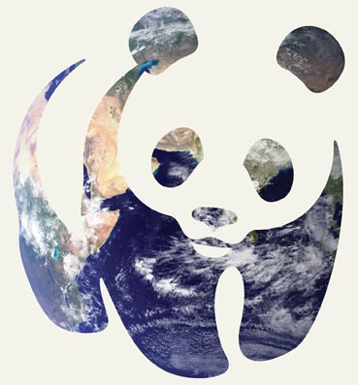
WWF IN SHORT
WWF na kratko
+80
+2,500
WWF is in over
80 countries, on
5 continents
WWF has over
2,500 staff worldwide
WWF ima več kot 2500 zaposlenih po celem svetu.
WWF prisotna v več kot 80. državah na 5. kontinentih.
1961
+5M
WWF was founded
In 1961
WWF has over
5 million supporters
WWF je bila ustanovljena leta 1961.
WWF podpira več kot 5 milijonov privržencev.
Photo: © NASA
Notes:
3
WWF stands for “World Wide Fund for Nature”. It’s one of the worlds largest conservation organizations. It was conceived in 1961. The central secretariat is located in Switzerland. It’s an independent foundation.

Slide 4
A Roadmap for a Living Planet
Why WWF?
Zakaj WWF?
Because the pressure on our earth grows!
Causes and effects
Ker se pritiski na našo Zemljo večajo!
Vzroki in posledice
25 September 2012 - 4
WWF Austria
Notes:
4

Slide 5
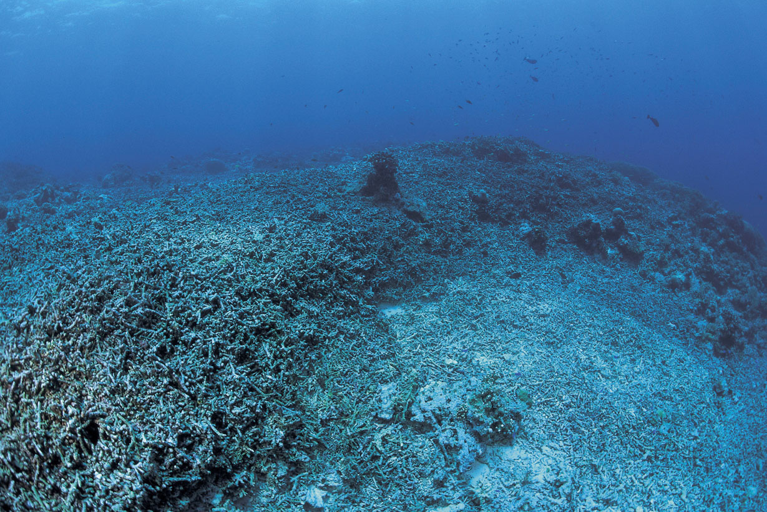
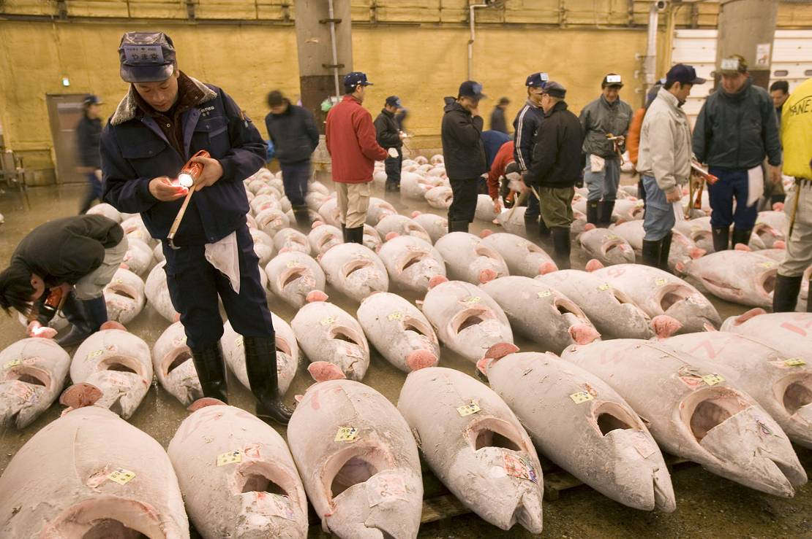
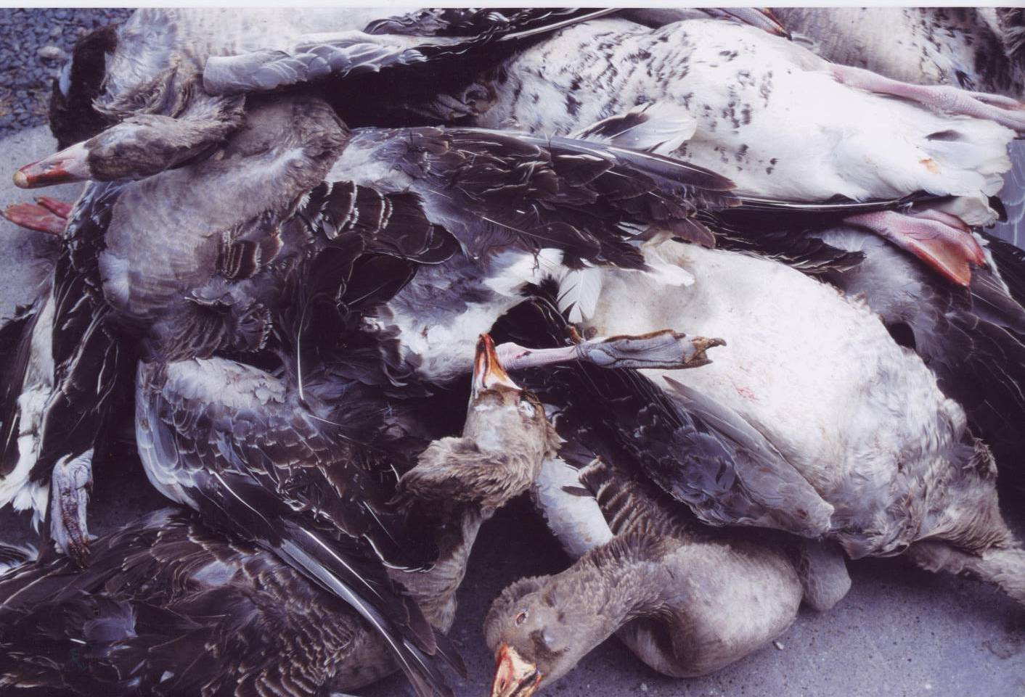
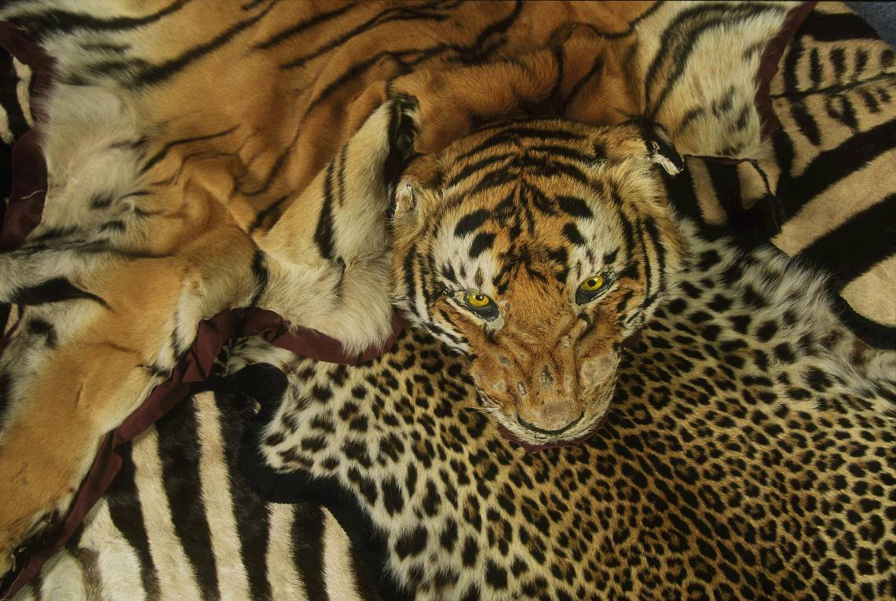
Furchtbare Fotos Artensterben Zahlen zu Artensterben
Extinction of species
Izumiranje vrst
Notes:
5
WHY?
Species extinct because of excessive fishery, hunting, production of food or medicine.
Fotos von links nach rechts:
Zerstörtes Korallenriff – Thunfische am Fischmarkt – Gänse ganz tot – Raubkatzenfell (CITES kann erwähnt werden)
Übernutzung einer Art, besonders durch Fischerei oder Jagd bzw. durch die Herstellung von Nahrungsmittel, Medikamenten (Heilpflanzen), oder Werkstoffen.
CITES reguliert den internationalen Handel mit über 30.000 Tier- und Pflanzenarten sowie Produkten, die aus diesen hergestellt wurden. Dies dient dem Schutz wild lebender Bestände von gefährdeten Arten.
Ausbreitung durch invasiver Arten oder Gene, die oft ohne Absicht von einem Teil der Erde in einen anderen gebracht werden. Besonders betroffen Nordamerika und Australien, da diese jüngere Ökosysteme im Vergleich zu Europa sind.
IAS: Invasive Alien Species
DAISIE: Delivering Alien Invasive Species Inventories for Europe
www.europe-aliens.org

Slide 6
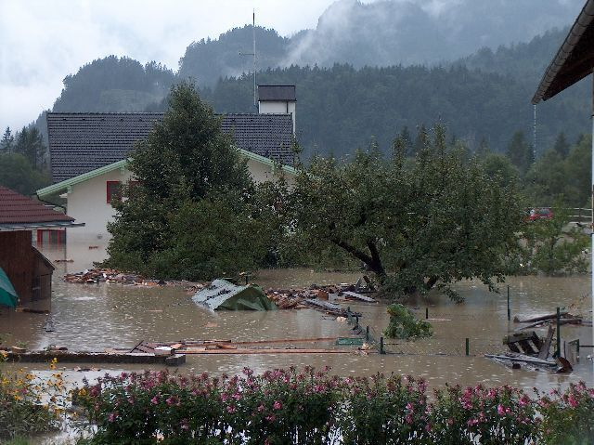
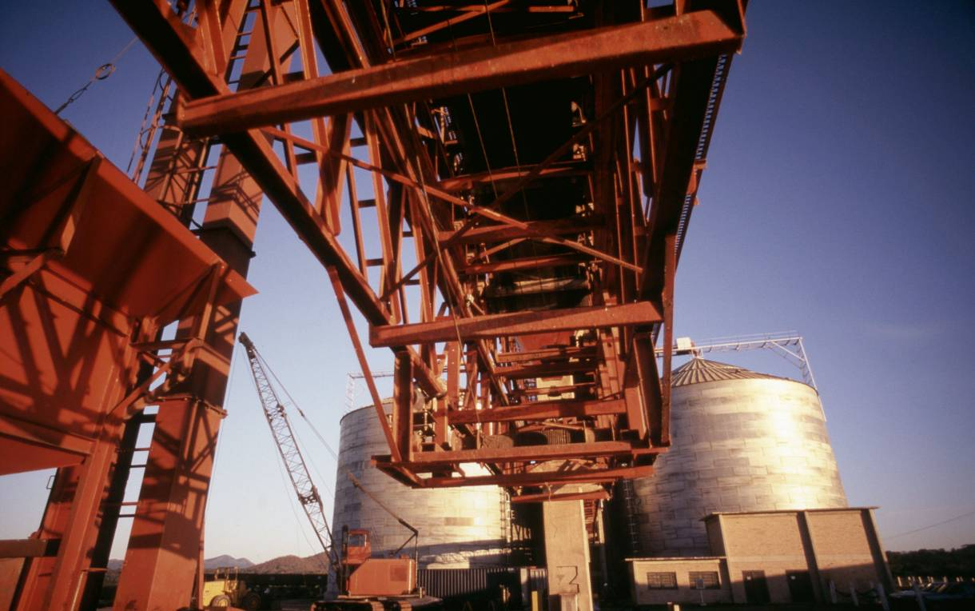

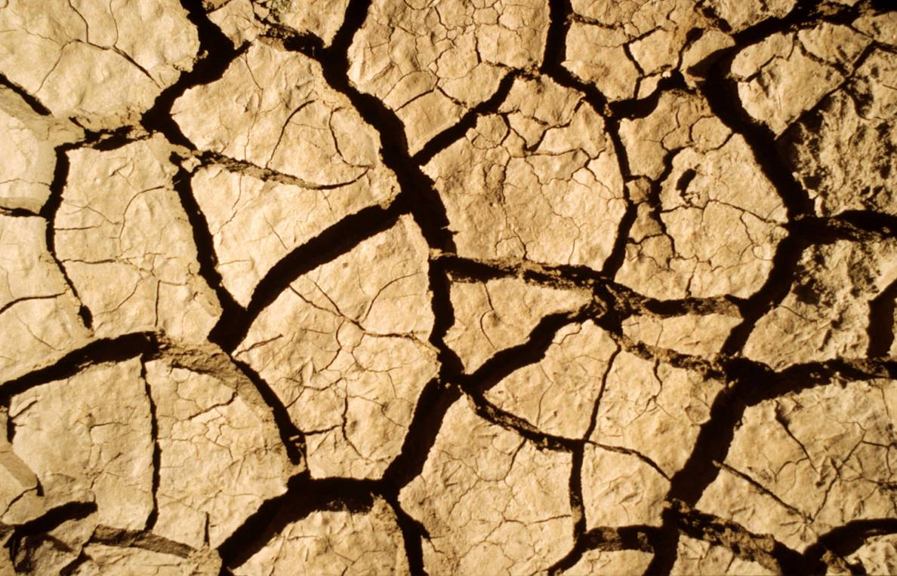
Environment destruction
Uničevanje okolja
Notes:
6
Environmental destruction because of the pollution of the environment due to fertilizers, pesticides, industry waste,…
Fotos von links nach rechts:
Überschwemmung, Hochwasser – Industrie Containeranlage – Verkehr – ausgetrocknete Erde
Verursacht durch Verschmutzung
Eutrophierung (Anreicherung vom Nährstoffen)
Düngemittel
Pestizide, giftige Chemikalien aus der Land- und Wasserwirtschaft
Industrie- und Bergbauabfälle
saurer Regen

Slide 7
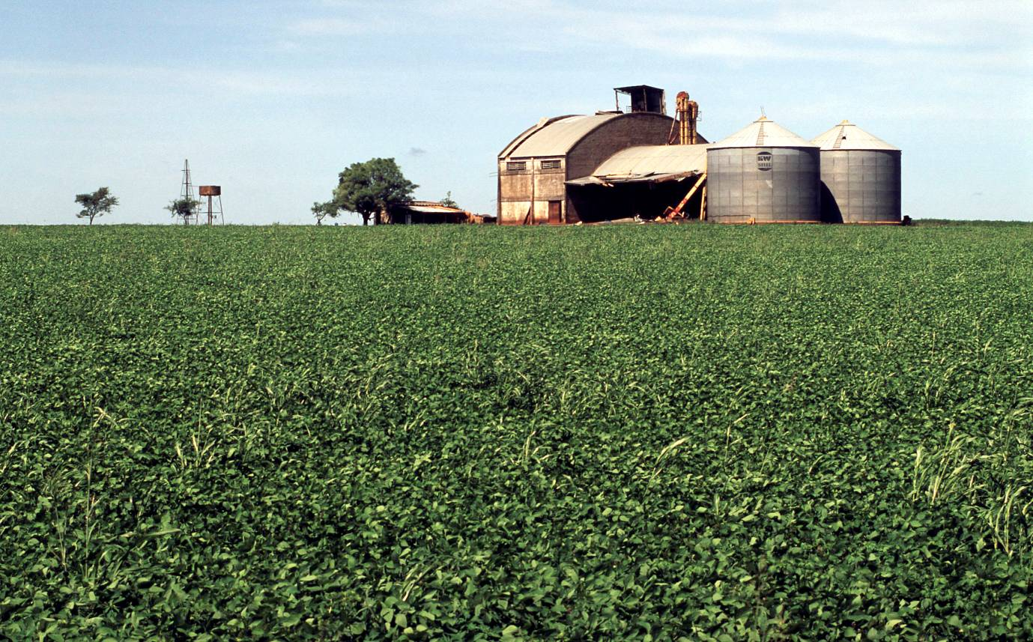
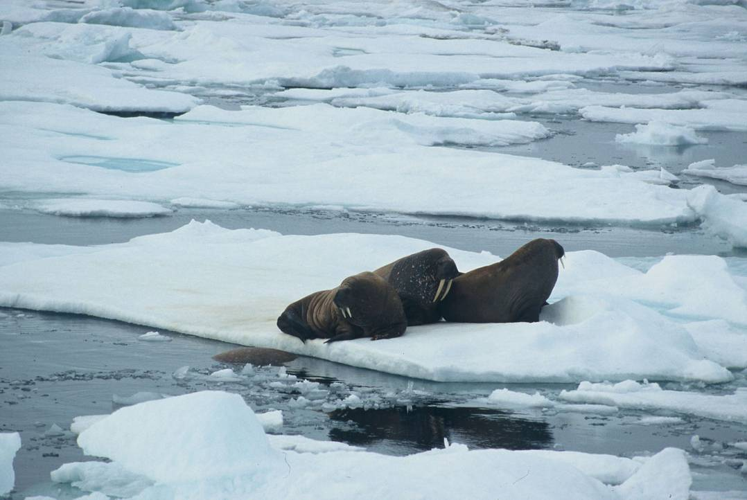
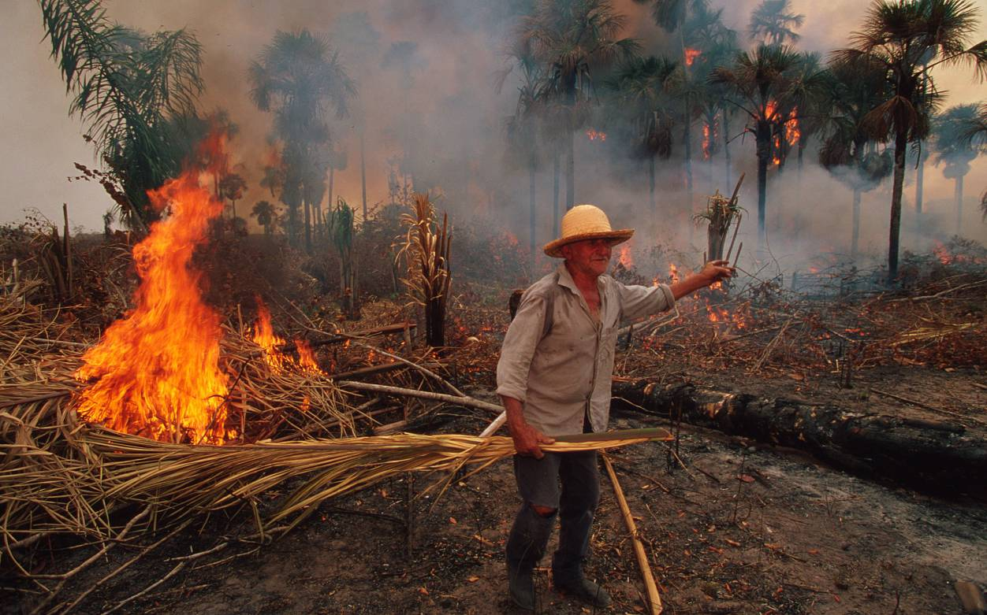
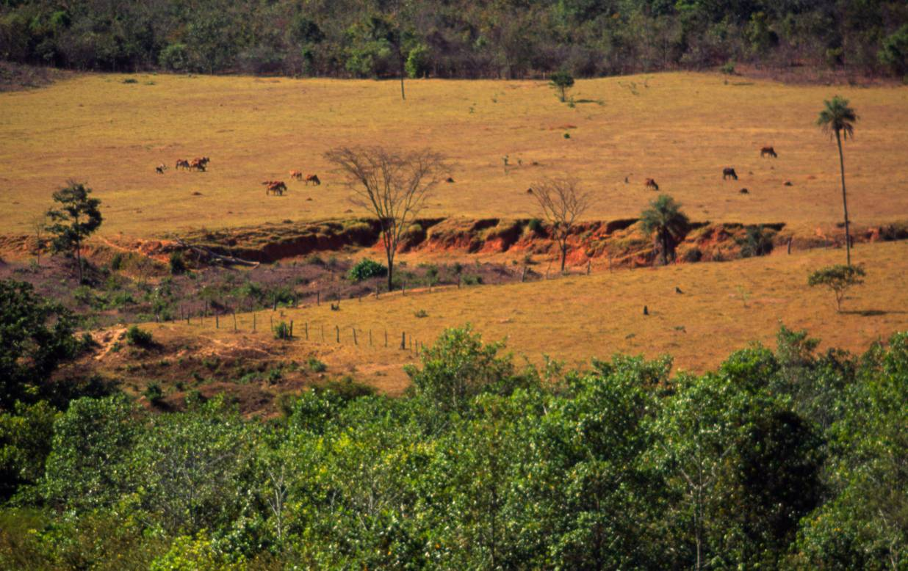
Loss of habitat
Izguba habitatov
Notes:
7
Loss of habitat due to loss or transformation of habitats mainly because of agriculture.
Fotos von links nach rechts:
Sojaplantage – Walrosse – Brandrodung – Erosion
Verlust oder Veränderung von Lebensraum besonders durch Landwirtschaft
Einschlag, Brandrodung von Wälder
Schädigung von Graslandschaften
Regulierung von Flüssen
Zerstörung von Meeresboden (z.B. Schleppnetzfischerei)
Definition zur ökologischen Nachhaltigkeit (sollte spätestens hier erwähnt werden):
Ökologische Nachhaltigkeit ist eine Lebensweise, die die natürlichen Lebensgrundlagen nur in dem Maße beansprucht, wie diese sich regenerieren.

Slide 8
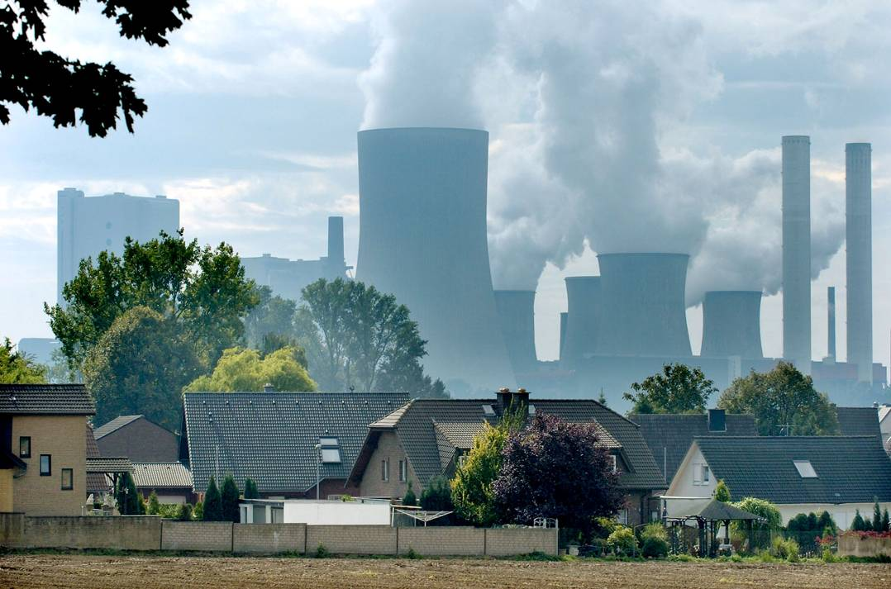
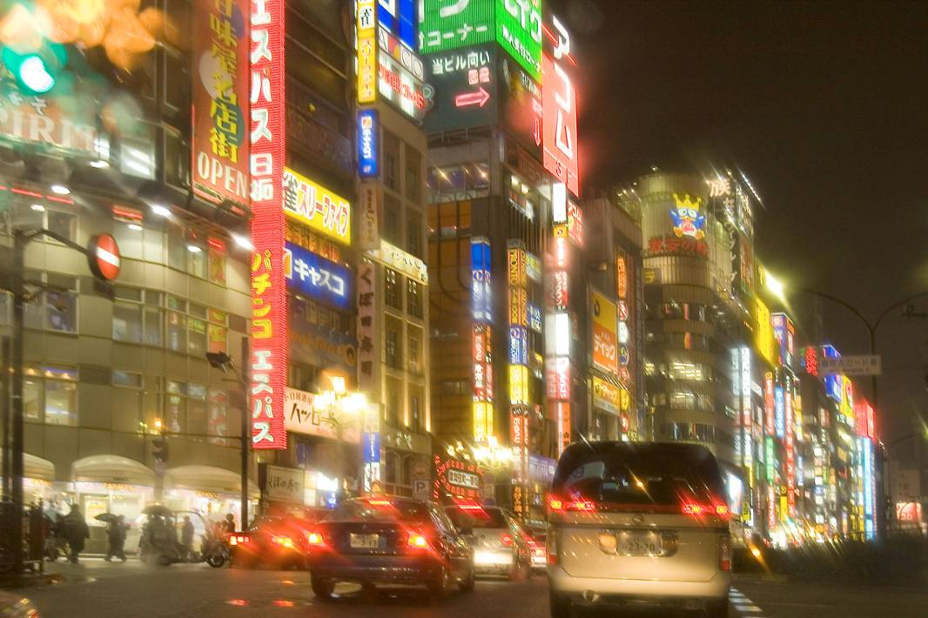
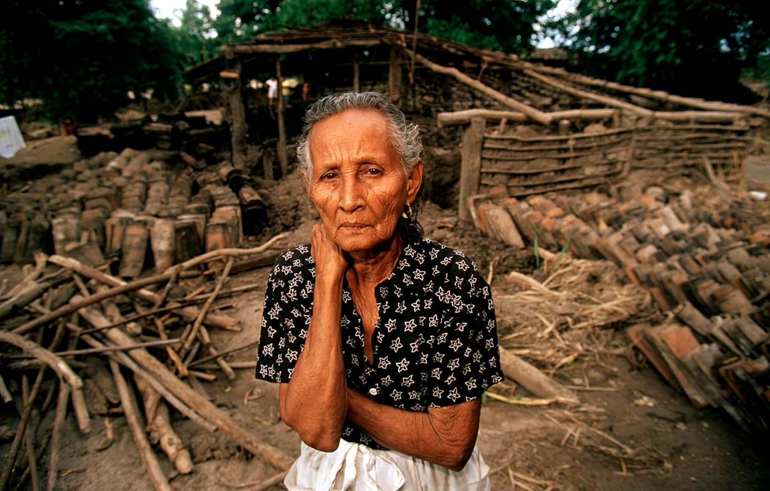
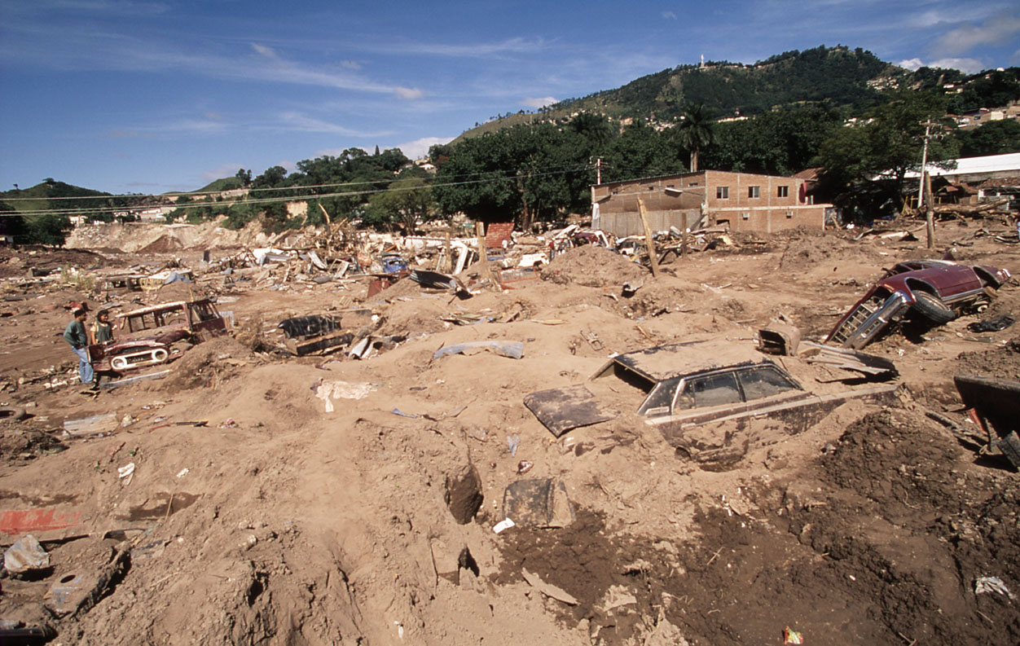
Climate change
Podnebne spremembe
Notes:
8
The emission of carbon dioxide, methane and other greenhouse gases causes the climate change.
Fotos von links nach rechts:
Industrie – Verkehr – Zerstörtes Haus mit Frau – Hurrikan
Bedrohung und Belastung durch die Nachfrage des Menschen nach Nahrungsmittel, Wasser, Energie und Werkstoffe → Produktion und Konsum von Agrarerzeugnissen, Fleisch-, Molkereiprodukten, Fisch, Meeresfrüchten, Nutzholz, Papier, Wasser, Energie, Ressourcen für Verkehr und Flächen für Städte und Infrastruktur (Verbrennung fossiler Brennstoffe)
Klimawandel verursacht durch Kohlendioxid, Methan und anderen Treibhausgasen

Slide 9
A Roadmap for a Living Planet
WWF Mission
World Wide Fund for Nature
WWF Poslanstvo
We want to stop the degradation of the planet’s natural environment and build a future in which humans live in harmony with nature, by
  Conserving the world’s biological diversity
  Ensuring that the use of renewable natural resources is sustainable
  Promoting the reduction of pollution and wasteful consumption
Želimo ustaviti planetarno uničenje naravnega okolja in zgraditi prihodnost, v kateri bodo ljudje živeli v harmoniji z naravo, tako da:
  Ohranjamo svetovno biološko pestrost
  Zagotavljamo trajnostno rabo obnovljivih virov
  Spodbujamo zmanjšanje onesnaževanja in pretirane porabe
25 September 2012 - 9
WWF Austria
Notes:
9
Biodiversity: to ensure that the earth’s web of life stays healthy and vibrant for generations to come. We are strategically focusing on conserving critical places and critical species that are particularly important for the conservation of our earth’s rich biodiversity
Ecological Footprint: to reduce the negative impacts of human activity. We are working to ensure that the natural resources required for life are managed sustainably and equitably.

Slide 10
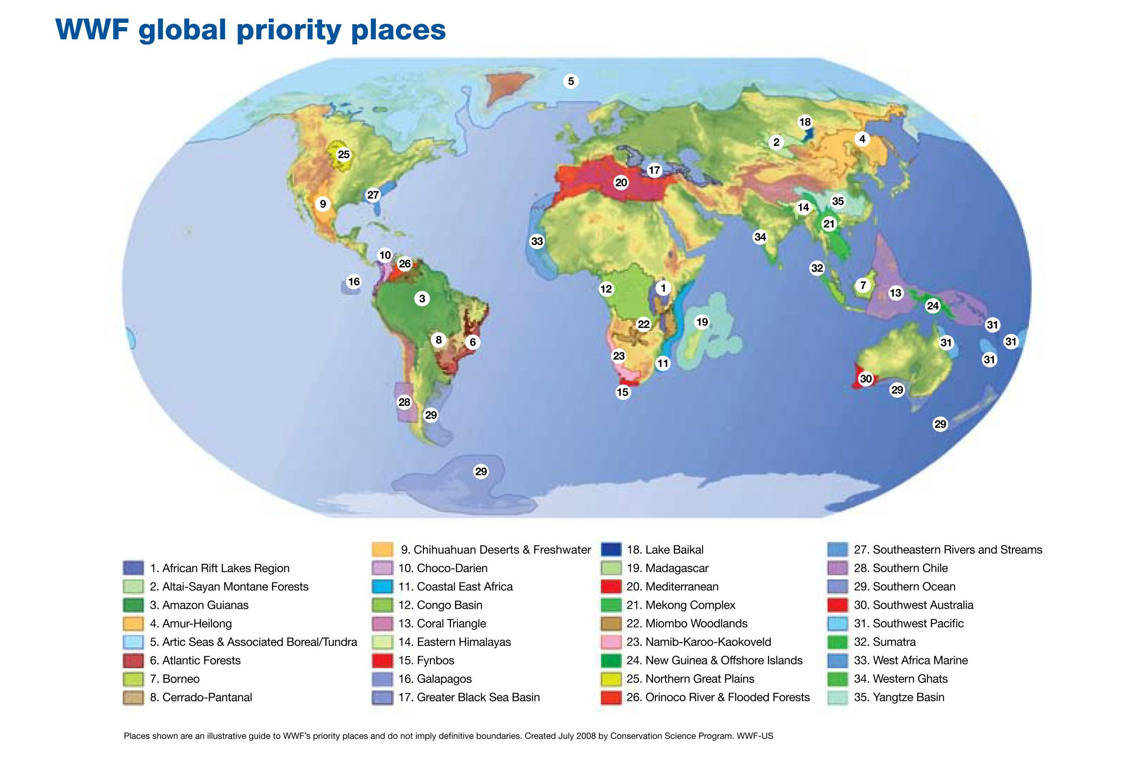
ESFALP IV
A Roadmap for a Living Planet
Prioritete WWF po svetu
25 September 2012 - 10
WWF Austria
Notes:
10
Why these places?
These regions have been scientifically identified as:
being home to irreplaceable and threatened biodiversity, or
representing an opportunity to conserve the largest and most intact representative of their ecosystem.
We are also working in a number of regional priority areas that are locally important and have a long history of WWF conservation success.

Slide 11
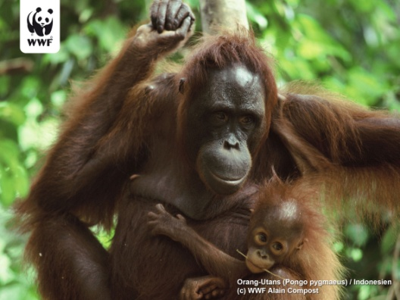
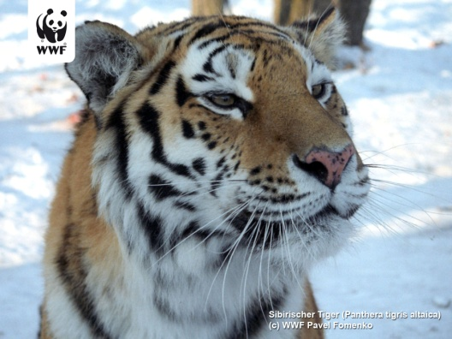
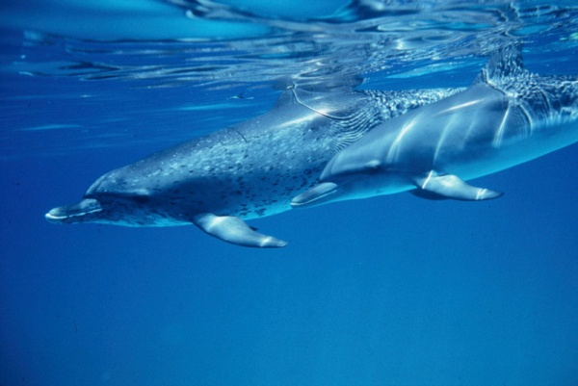
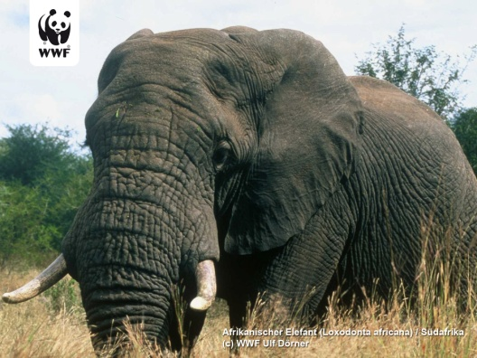
ESFALP IV
A Roadmap for a Living Planet
PRIORITY
SPECIES
Prioritetne
vrste
African elephant
African great apes
African rhinos
Asian big cats
Asian elephant
Asian rhinos
Giant panda
Marine cetaceans
afriški slon
afriške velike opice
afriški nosorogi
azijske velike mačke
azijski slon
azijski nosorogi
veliki panda
morski sesalci (kiti, delfini)
Marine turtles
Orang-utans
Polar bear
River dolphins
Threatened kangaroo species
Plus footprint-impacted species (African teak, Tuna, Ginseng,…)
morske želve
orangutani
polarni medvedi
sladkovodni delfini
ogrožene vrste kengurujev
plus vrste, ki so odvisne od ekološkega odtisa (afriški tik, tuna, ginseng,…)
25 September 2012 - 11
WWF Austria
Notes:
11
WWF is focusing efforts on a select group of priority species that are especially important, either for their ecosystem...
Species forming a key element of the food chain
Species which help the stability or regeneration of habitats
Species demonstrating broader conservation needs
...or for people
Species important for the health and livelihoods of local communities
Species exploited commercially
Species that are important cultural icons.
These species fall into two groups:
Flagship species – iconic animals that provide a focus for raising awareness and stimulating action and funding for broader conservation efforts
Footprint-impacted species – species whose populations are primarily threatened because of unsustainable hunting, logging or fishing.
Strategially focusing efforts on these species will also help conserve the many other species which share their habitats and/or are vulnerable to the same threats.

Slide 12
A Roadmap for a Living Planet
How does WWF work?
Kako WWF deluje?
  We tackle the causes.
  We focus our efforts.
  We capitalize on our expertise.
  We build strong partnerships.
  Odpravljamo vzroke.
  Osredotočeni smo na naša prizadevanja.
  Zanašamo se na naše strokovno znanje.
  Gradimo močna partnerstva.
25 September 2012 - 12
WWF Austria
Notes:
12
We tackle the causes.
In order to achieve large-scale, long-lasting impacts, we must tackle the underlying causes to environmental degradation. WWF has identified 5 drivers that fuel environmental change -both good and bad. By engaging these key actors, we seek to reverse current trends and to drive greener policies and practices.
We focus our efforts.
Given limited resources, restricted funds and the fact that we're running out of time, WWF is focusing its efforts on 13 Global Initiatives. These are visionary, large-scale efforts that can have the potential for the broadest positive impacts.
We capitalize on our expertise
WWF's on-the-ground work is powered by the dedicated people in our expert programmes – including leading conservation scientists, policy experts, economists, lawyers, and communications experts.
We build strong partnerships.
WWF cannot achieve its goals alone. Strong partnerships with businesses, governments, finance institutions, local communities, academia and other NGOs are essential for driving change at the scale needed.
In everything we do we will:
Be global, independent, multicultural and non-party political.
Use the best available scientific information to address issues and critically evaluate all its endeavours
Seek dialogue and avoid unnecessary confrontation
Build concrete conservation solutions through a combination of field based projects, policy initiatives, capacity building and education work
Involve local communities and indigenous peoples in the planning and execution of igts field programmes, respecting their cultural as well as economic needs
Strive to build partnerships with other organizations, governments, business and local commu nities to enhance WWF’s effectiveness
Run its operations in a cost effective manner and apply donors’ funds according to the highest standards of accountability

Slide 13
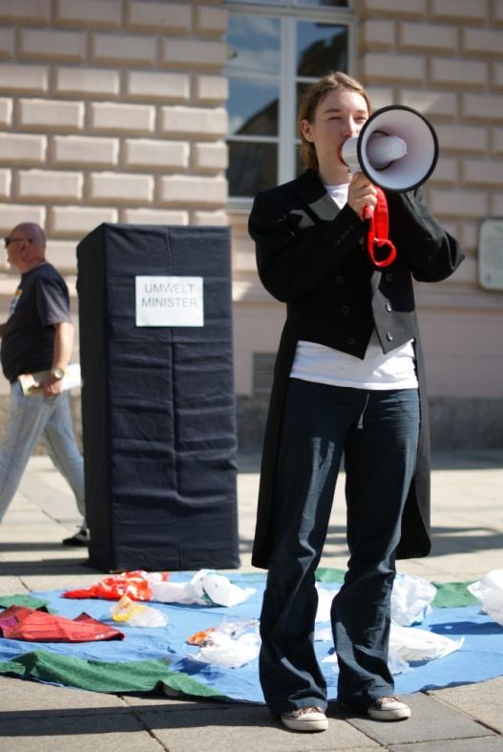
MOBILIZE PEOPLE
VKLJUČEVANJE LJUDI
“The most important task, if we are to save the Earth, is to educate.”
Sir Peter Scott, founder WWF
“Najpomembnejša naloga, če želimo rešiti Zemljo je, da izobražujemo.”
g. Peter Scott, ustanovitelj WWF
25 September 2012 - 13
WWF Austria
Notes:
13

Slide 14
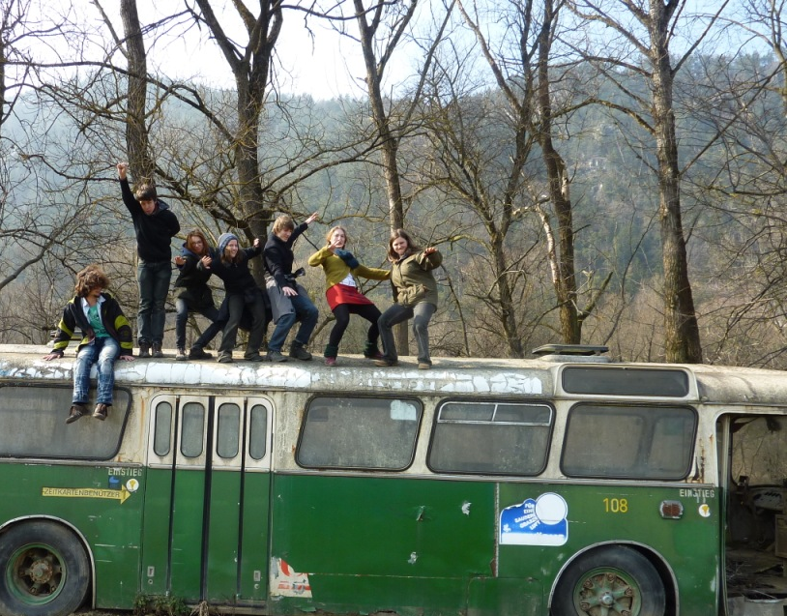
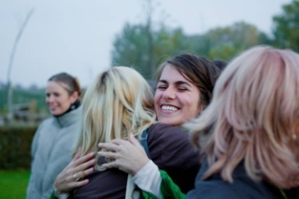
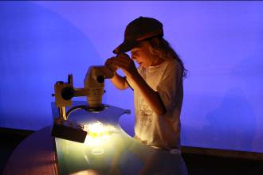
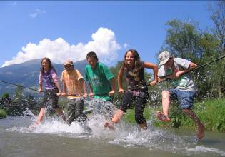
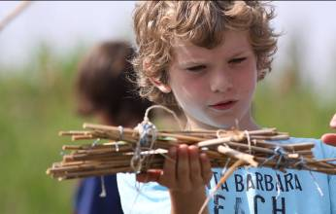
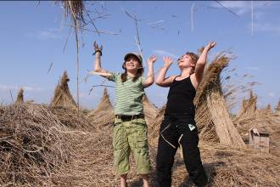
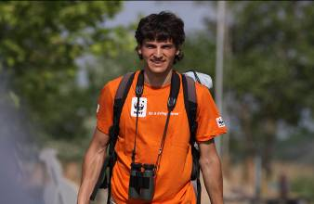
A Roadmap for a Living Planet
  „Active citizenship“
  „Youth Empowerment“
  Peer to Peer
WWF Austria
Notes:
Motivate, interest and attitude – behaviour
We want to support youth to become active citizens, so they play an important role in public life, are interested in current topics. They get to know their rights and responsibilities and take part in decision-making processes and how they can get active to make a change.
14

Slide 15
One focus: Wetlands
Ena od usmeritev: Mokrišča
What are wetlands and why are they important
SHOW MOVIE
What are the threats
Kaj so mokrišča in zakaj so pomembna
Kaj jim grozi
Notes:
„Wetlands are areas of marsh, fen, peatland or water, whether natural or artificial, permanent or temporary, with water that is static or flowing, fresh, brackish or salt, including areas of marine water, the depth of which at low tide does not exceed six meters“ (Davis 1994)
WWFs work on freshwater:
Amazon
Amur-Heilong
Congo
Mekong
Danube

Slide 16
What is the current situation of rivers in the Danube Basin?
Kakšno je trenutno stanje rek v povodju Donave?

Slide 17

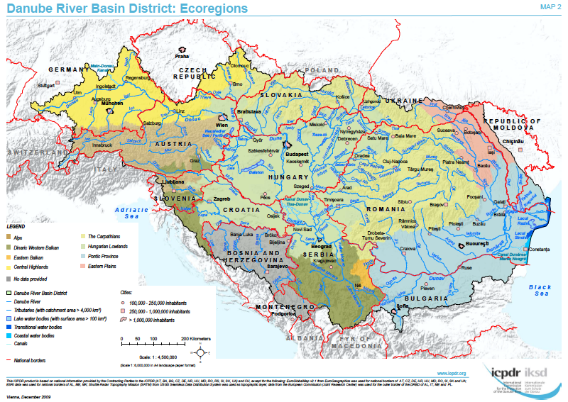
Danube – Carpathian region
Donavsko – Karpatska regija
Notes:
17
Danube basin (800.000 Km2) – Danube and its network of tributaries with headwaters in the Carpathians and Alps; 8 eco-regions
Differences across the region in economic development, increasing pressure from economic growth
EU and non-EU countries
Outstanding natural values – species and habitats, networks of protected areas – ecological corridors
Challenges to prioritise conservation needs and address threats
Threats: examples: habitat destruction, flow modification, over-use/exploitation (hydropower, storage), abstraction (surface and groundwater), climate change, invasive species, pollution,…..

Slide 18
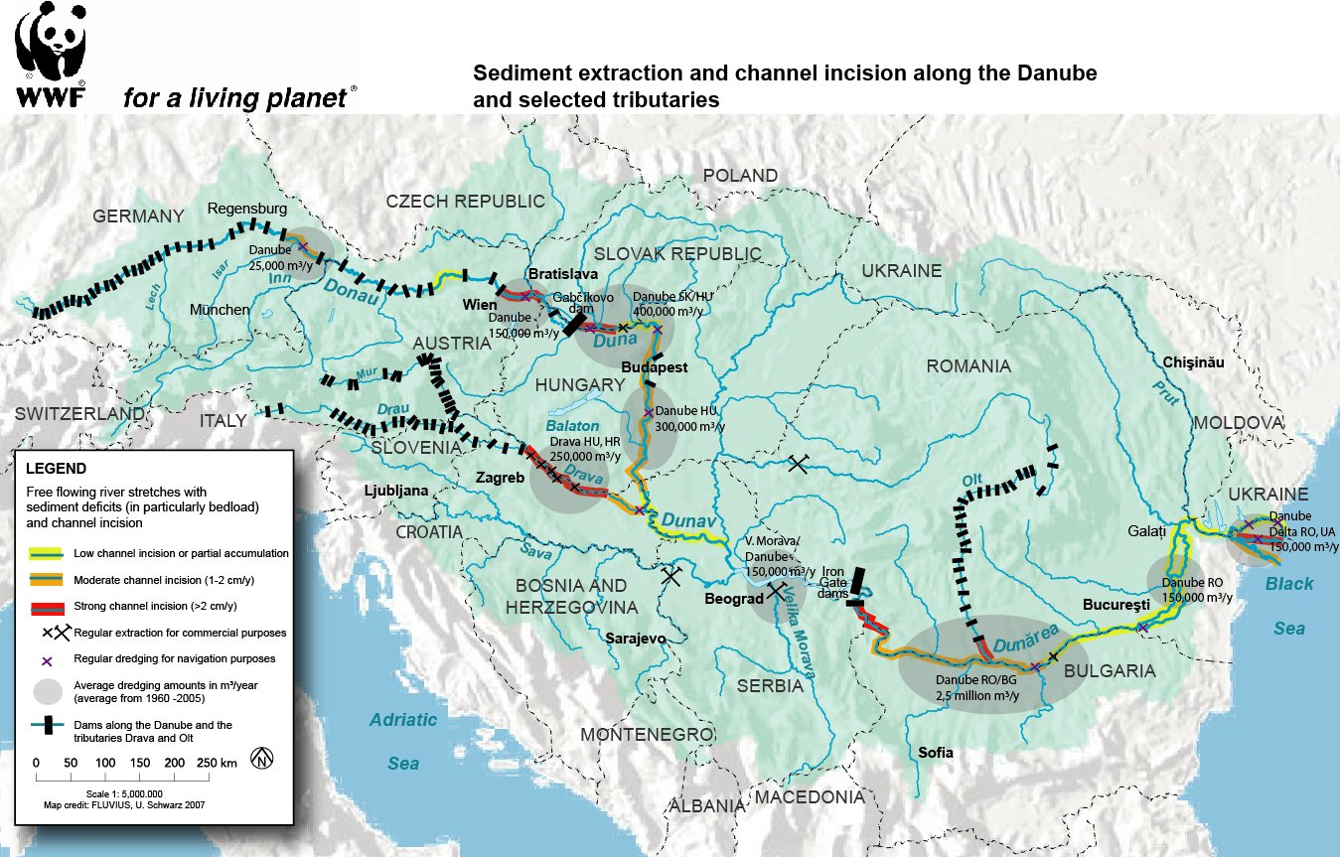
Baseline/Status – disconnected rivers & habitats (2)
Izhodišče/Status – prekinitve rek & habitatov (2)
Notes:
18
And dams, we don’t have yet a map with the hydropower impact for the Danube basin
Conversion of floodplains into agricultural land, fishponds, natural floodplain forest – hybrid poplar/willow plantations => dramatic loss of habitats, species, ecosystem productivity, loss of biodiversity – shifts in the plant and animal communities composition
Reduced floodplain with 70% (80% for all assessed rivers)
Drave -77%
Baseline: 500.000 ha restoration potential (400.000ha RO) but fulfillment of objectives shifted to 2027; Estimated 65,000 ha across the Danube as for December 2009. Of this, ca 60,000 ha is on the Lower Danube. Projects initiated in RO, BG, UA, HU, AT/SK, DE.

Slide 19
Varstvena območja vzdolž Donave, Drave in Mure
Notes:
The Lower Danube is the last free-flowing section of the river downstream Iron Gates

Slide 20
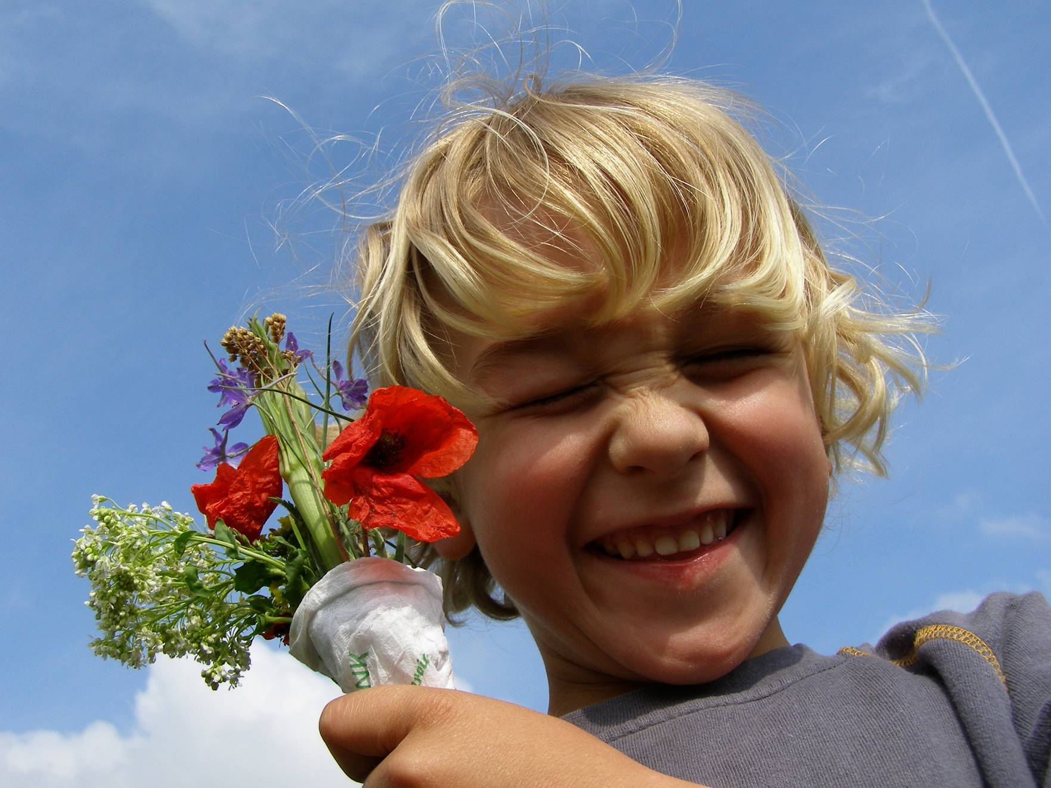
Thank you
Hvala.
© 2010, WWF. All photographs used in this presentation are copyright protected and courtesy of the WWF-Canon Global Photo Network and the respective photographers.
WWF Austria

Slide 21
Websites to look at
Oglejte si spletne strani
www.freeyourriver.net – Info and Materials on rivers
www.foralivingplanet.eu – Weblog of the project „European Schools for a living planet“ – for information and inspiration ☺.
Ramsar Video of Wetlands: available on www.ramsar.org (Wetlands: keeping our planet alive and well)
If you want to „take action“ we can provide to you „community action planning guide“

